Slide 1
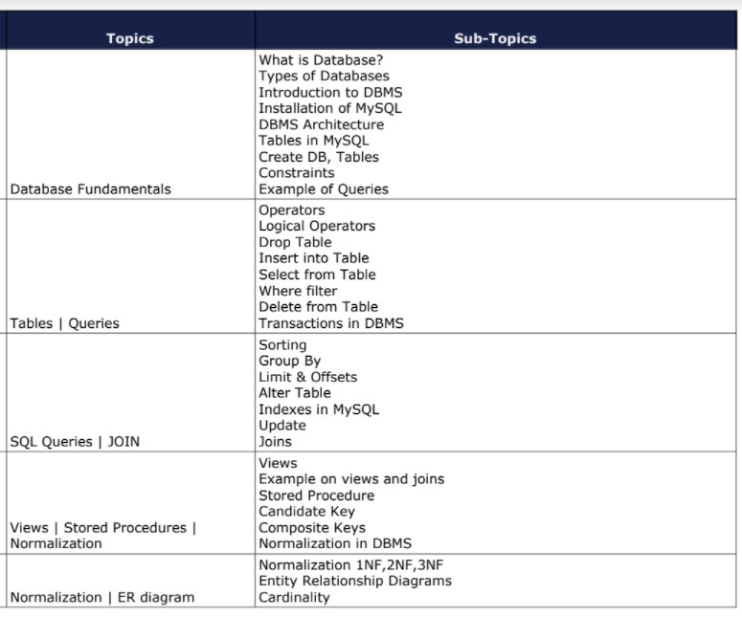
What would we cover?

Slide 2

MySQL , DBMS
MySQL is a relational database management system based on the Structured Query Language, which is the popular language for accessing and managing the records in the database. MySQL is open-source and free software under the GNU license. It is supported by Oracle Company.

Slide 3

1.What is SQL? 2.What is a database? 3.What is DBMS? 4.What is RDBMS? 5.What is the difference between SQL and MySQL?

Slide 4

what is SQL?
SQL stands for Structured Query Language
It is a standard language for accessing and manipulating the relational databases.

Slide 5

What is a database?
A Structured set of computerized data with an accessible interface

Slide 6

what is DBMS?
DBMS – Database Management System
App
DBMS
Database

Slide 7
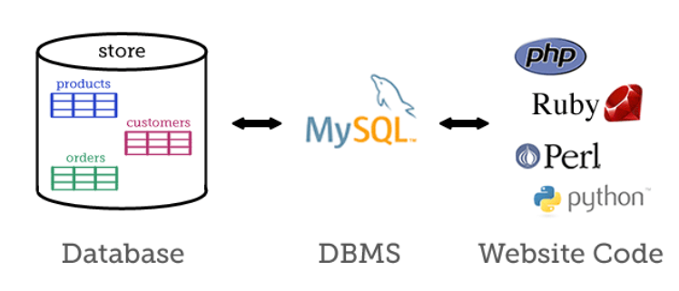
There are many great DBMSs out there, including MySQL, PostgreSQL, SQLite, Oracle, and SQL Server, and all of them can be used for most web development purposes.

Slide 8

What is RDBMS?
A Relational database management system (RDBMS) is a database management system (DBMS) that is based on the relational model as introduced by E. F. Codd.
The data in an RDBMS is stored in database objects which are called as tables. This table is basically a collection of related data entries and it consists of numerous columns and rows.

Slide 9

SQL Vs MySQL
SQL is the language we use to “talk” to our databases
Working with MySQL is primarily “writing SQL”

Slide 10
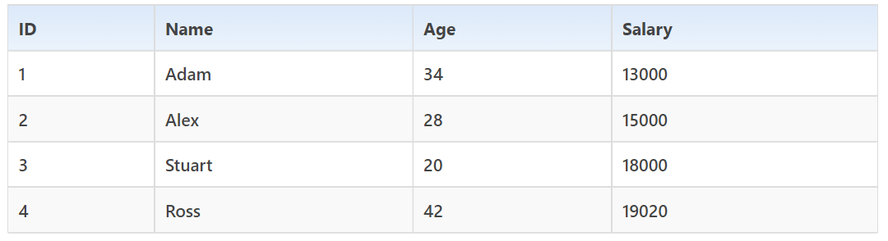
Employee Table

Slide 11
Record / Row
A single entry in a table is called a Record or Row. A Record in a table represents set of related data. For example, the above Employee table has 4 records. Following is an example of single record.

Slide 12
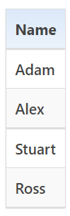
Field
A table consists of several records(row), each record can be broken into several smaller entities known as Fields. The above Employee table consist of four fields, ID, Name, Age and Salary.
Column
In Relational table, a column is a set of value of a particular type. The term Attribute is also used to represent a column. For example, in Employee table, Name is a column that represent names of employee.

Slide 13
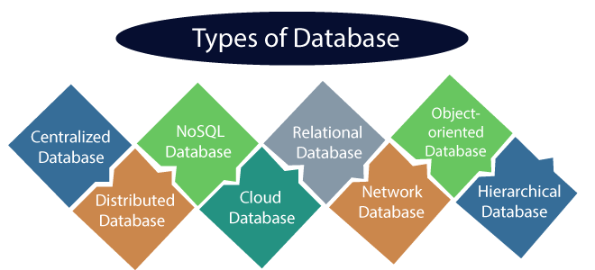
https://www.javatpoint.com/types-of-databases

Slide 14
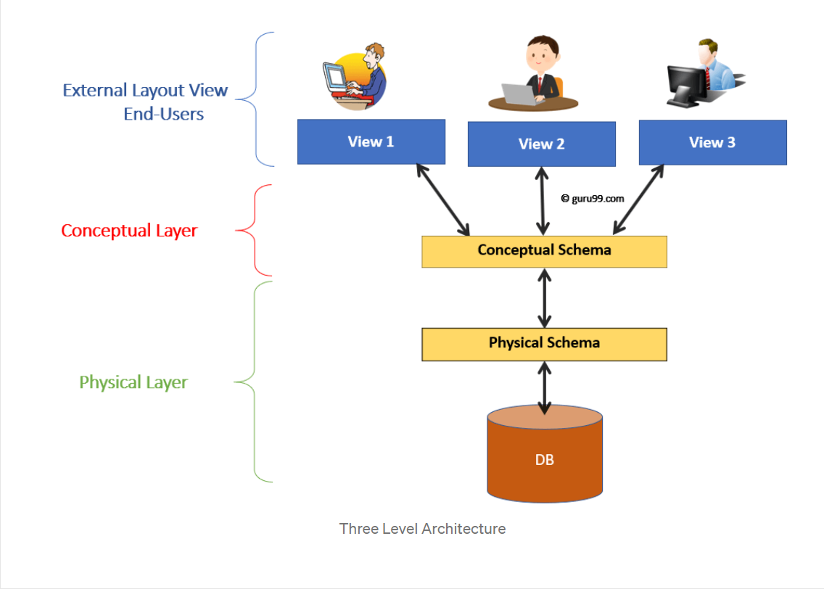

Database Architecture

Slide 15
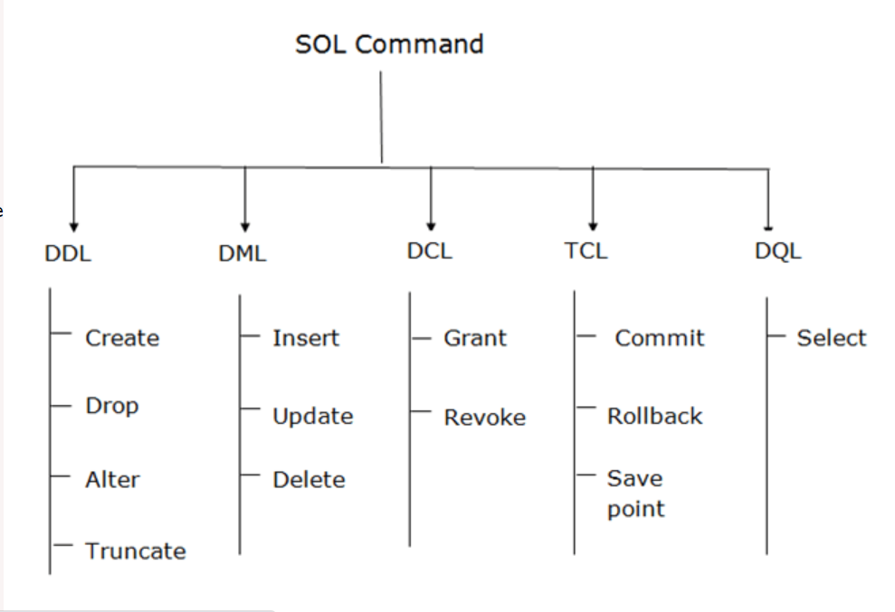
SQL Statements Category

Slide 16

Constraints
Constraints enforce limits to the data or type of data that can be inserted/updated/deleted from a table. The whole purpose of constraints is to maintain the data integrity during an update/delete/insert into a table.
NOT NULL - NOT NULL constraint makes sure that a column does not hold NULL value.
UNIQUE - UNIQUE Constraint enforces a column or set of columns to have unique values.
DEFAULT - The DEFAULT constraint provides a default value to a column when there is no value provided while inserting a record into a table.
CHECK - This constraint is used for specifying range of values for a particular column of a table.
Key Constraints – PRIMARY KEY, FOREIGN KEY
Primary key uniquely identifies each record in a table. It must have unique values and cannot contain nulls.
Foreign keys are the columns of a table that points to the primary key of another table. They act as a cross-reference between tables.

Slide 17
Mysql Workbench Installation
https://www.simplilearn.com/tutorials/mysql-tutorial/mysql-workbench-installation

Slide 18
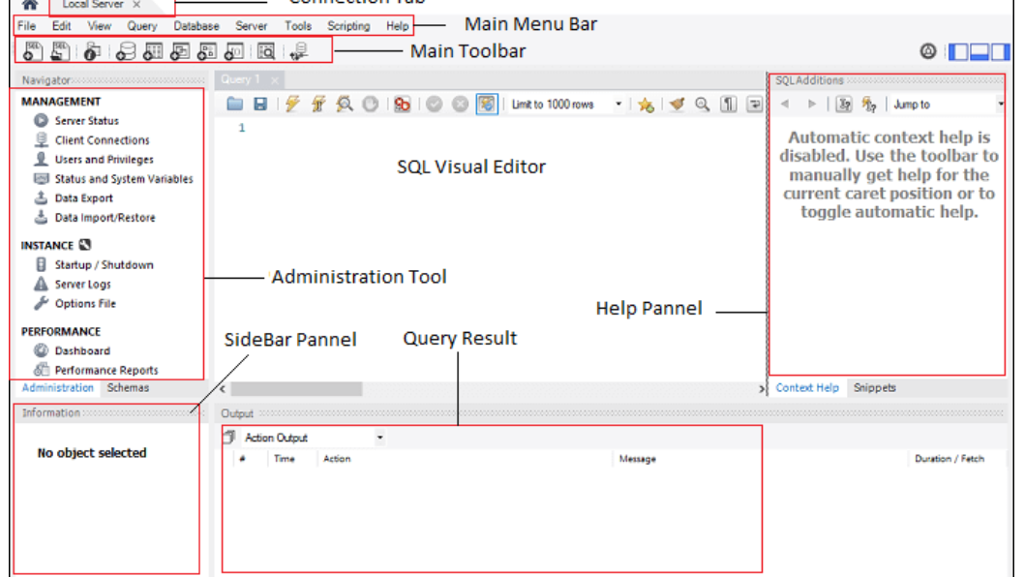

Slide 19
mysql –version
mysql -u root –p
Start mysql server
https://www.mysqltutorial.org/mysql-adminsitration/start-mysql/
Shell
https://www.cs.sjsu.edu/~mak/tutorials/MySQLShell.pdf

Slide 20
Now let’s dive into queries

Slide 21
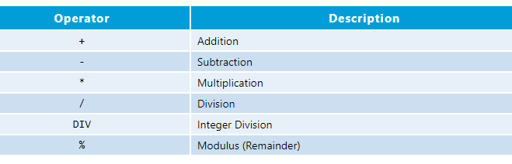
Arithmetic Operators You can perform arithmetic operations on numeric fields using arithmetic operators, as tabulated below:

Slide 22
Drop Vs Truncate
You can also use the DROP TABLE command to delete the complete table, but it will remove complete table data and structure both. You need to re-create the table again if you have to store some data. But in the case of TRUNCATE TABLE, it removes only table data, not structure. You don't need to re-create the table again because the table structure already exists.

Slide 23
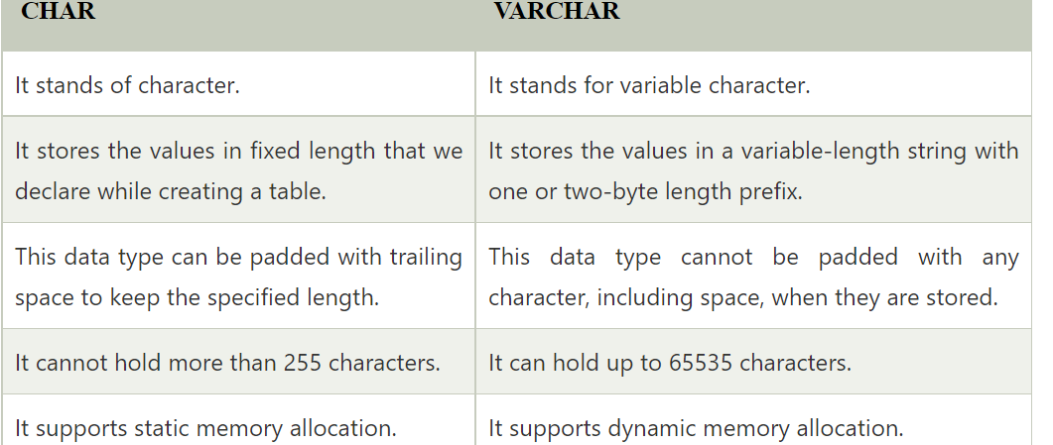
Char Vs Varchar

Slide 24
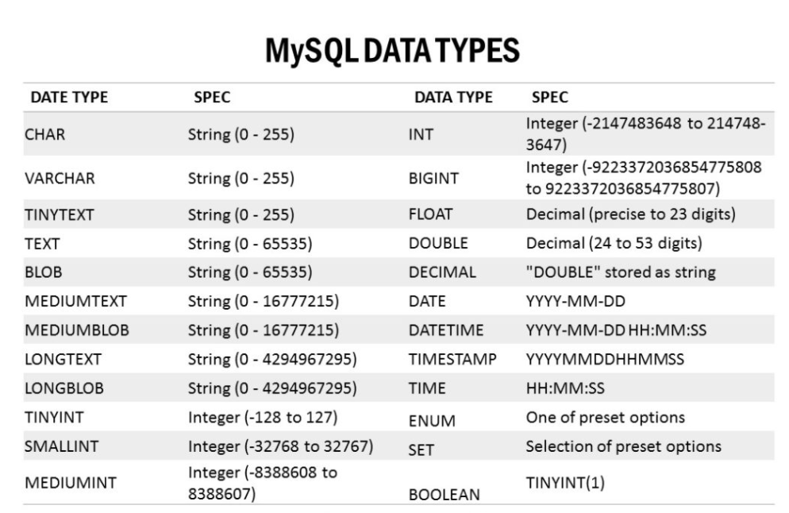

Slide 25
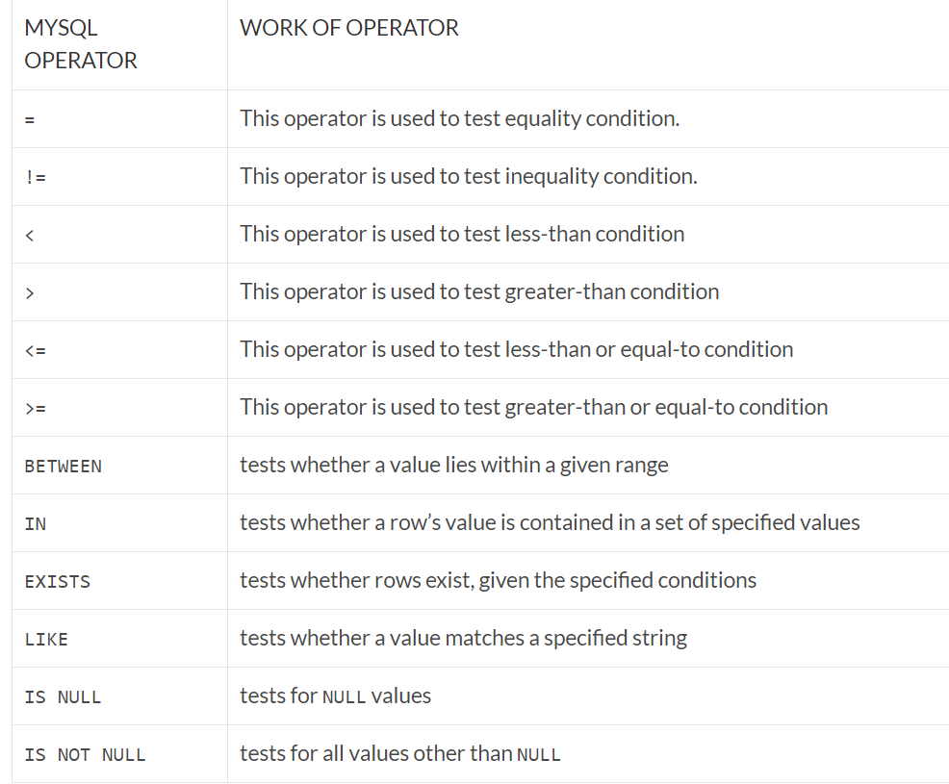
Operators

